Slide 1
CSE 495B(Natural Language Processing) Lecture 8
Use Self-Attention to Neural Networks: Attention is all you need

Slide 2

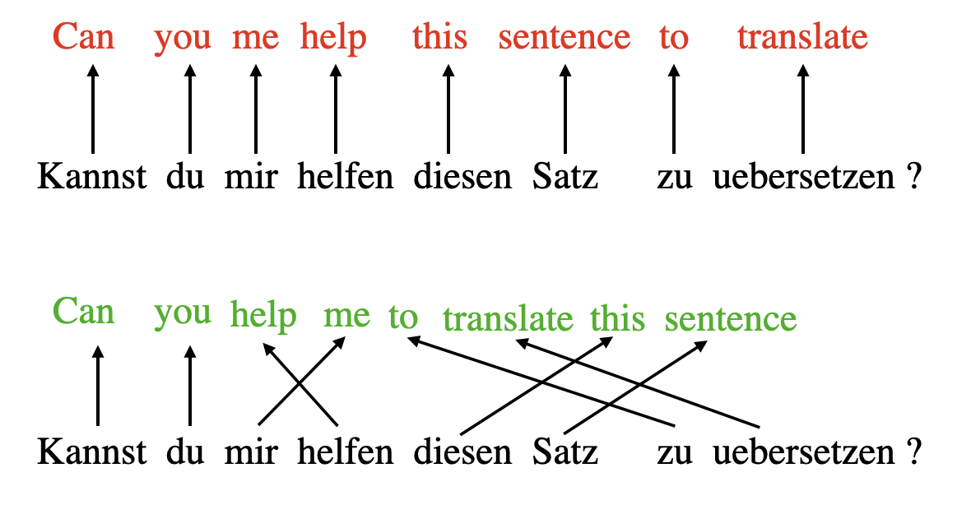
Multiple types of context

Slide 3
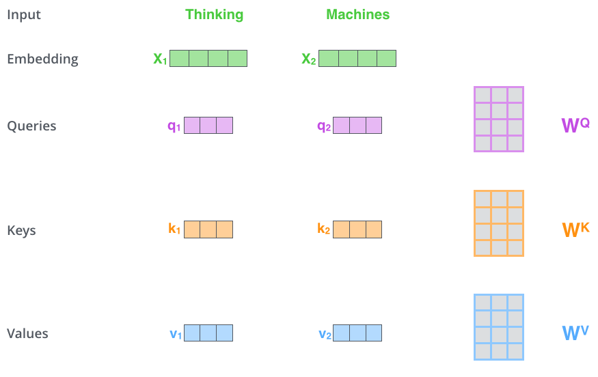
Self Attention: Projection
The first step in self-attention is to create vectors from the embedding of each word.
From each word, create a Query vector, a Key vector, and a Value vector.
These vectors are created by multiplying the embedding by three matrices that we trained previously.
These new vectors are smaller in dimension than the embedding vector.
Their dimensionality is 64, while the embedding and encoder input/output vectors have dimensionality of 512.

Slide 4
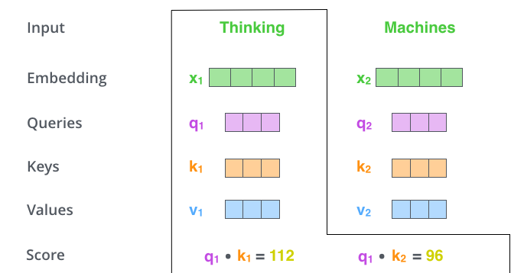
Self Attention: The (concept) weight
The second step in self-attention is to calculate a score/weight.
Say we’re calculating the self-attention for the first word in this example, “Thinking”.
We need to score each word of the input sentence against this word.
The score determines how much focus to place on other parts of the input sentence as we encode a word at a certain position.
The score is calculated by taking the dot product of the query vector with the key vector of the respective word.
So if we’re processing the self-attention for the word in position #1, the first score would be the dot product of q1 and k1. The second score would be the dot product of q1 and k2.

Slide 5
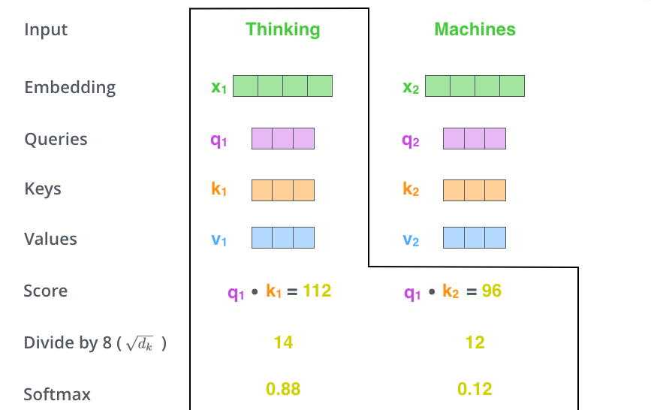
Self Attention: Normalizing concept weight
The third and fourth steps are to divide the scores by the square root of the dimension of the key vectors used.
This step ensures more stable gradients.
Then pass the result through a softmax operation.
Softmax normalizes the scores so they’re all positive and add up to 1.

Slide 6
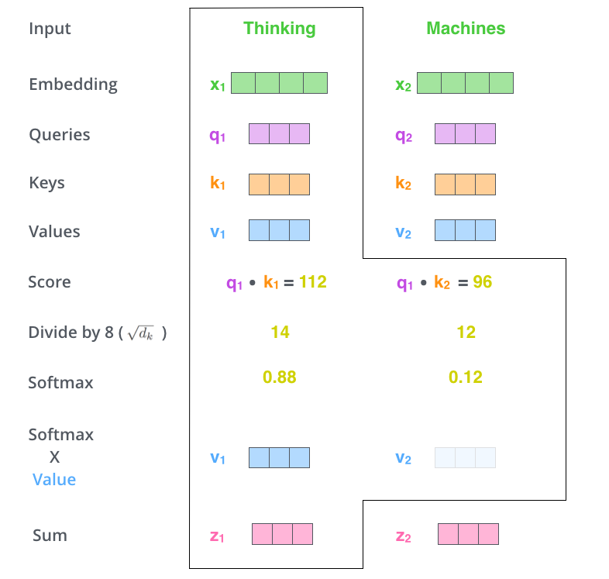
Self Attention: New Embedding
The fifth step is to multiply each value vector by the softmax score (in preparation to sum them up).
The intuition here is to keep intact the values of the word(s) we want to focus on, and drown-out irrelevant words (by multiplying them by tiny numbers like 0.001, for example).
The sixth step is to sum up the weighted value vectors. This produces the output of the self-attention layer at this position (for the first word).

Slide 7
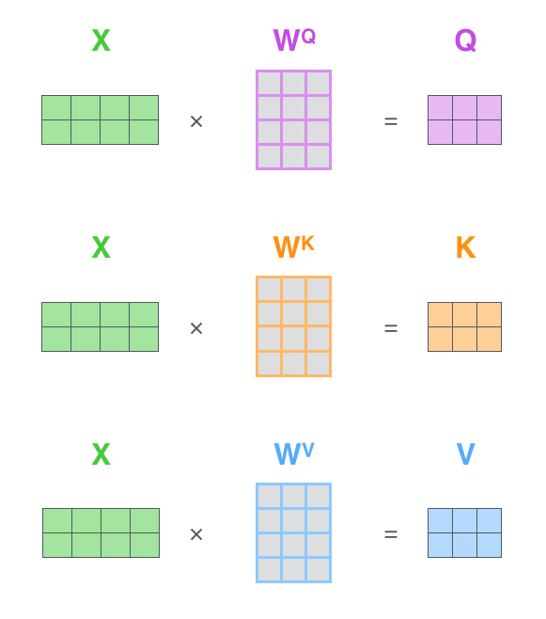
Getting Q,K,Vs
The first step is to calculate the Query, Key, and Value matrices.
We do that by packing our embeddings into a matrix X, and multiplying it by the weight matrices we’ve trained (W^{Q}, W^{K}, W^{V}).

Slide 8
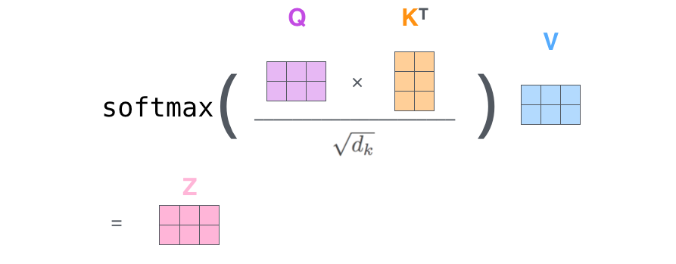
Everything as a Matrix Operation

Slide 9
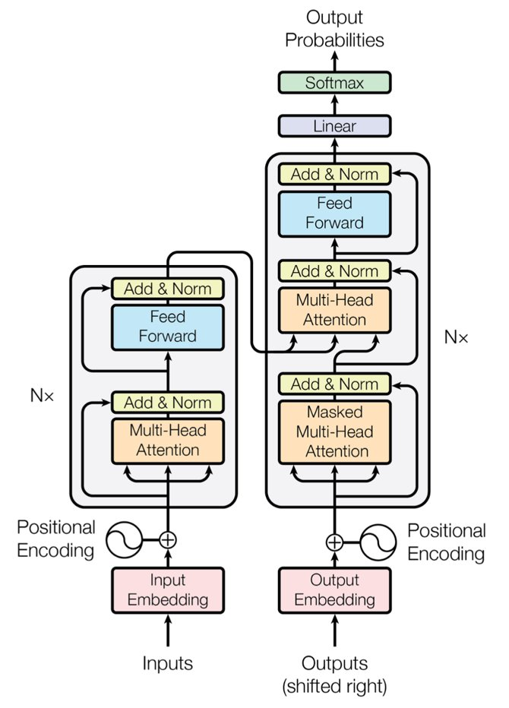
Attention is all you need
It is an encoder-decoder architecture
The input goes through encoder
Then through decoder
On the encoder side
Each block has two sublayers
Multihead attention then feedforward
On the decoder side
Each block has three sublayers
Two multihead attention followed by a feedforward layer
However, the first MHA layer is similar to the decoder MHA but the second one is different
The attention mechanism is a “word to word” operation
Token to token operation, but we can think of it at the word level to simplify the explanations
The attention mechanism will find how each word relates to all other words in a sequence, including the word being analyzed

Slide 10
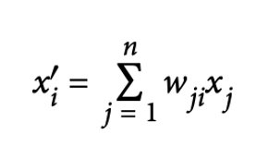
Self Attention
Attention is a mechanism that enables neural networks to assign varying levels of importance—or attention—to different elements in a sequence.
Instead of assigning a fixed embedding to each token, the model computes a weighted average of embeddings based on context.
Given a sequence of token embeddings x₁, ..., x_{n}, self-attention generates a sequence of new embeddings x₁′ , ..., x_{n}′ where each x′_{i} is a weighted sum of all x_{j}:
The coefficients w_{ji} are called attention weights and are normalized so that ∑_{j}w_{ji} = 1.

Slide 11
Self-dot-product attention
Several methods exist to implement self-attention layers, but scaled dot-product attention is the most widely used approach. It involves four key steps:
① Project embeddings into Query, Key, and Value vectors
Each token embedding is projected into three distinct representations: query (Q), key (K), and value (V).
② Compute Attention Scores
A similarity function calculates how closely related each query is to each key.
Scaled dot-product attention uses the dot product as the similarity measure, efficiently computed through matrix multiplication.
Tokens with similar queries and keys produce high attention scores, while unrelated tokens yield lower scores.
The result is an 𝑛×𝑛 attention-score matrix for a sequence of 𝑛 tokens.
Compute attention scores: Use a similarity function to measure how much each query relates to each key.
For scaled dot-product attention, the similarity is computed using the dot product, efficiently implemented via matrix multiplication.
Tokens with similar queries and keys will have high dot products, indicating strong relevance.
Tokens with unrelated queries and keys will have low or near-zero dot products.
The output is an n × n matrix of attention scores for an input of length 𝑛

Slide 12
Self-dot-product attention
③ Compute Attention Weights
Dot products can produce large numbers, potentially causing unstable training.
To address this, attention scores are divided by a scaling factor (typically sqrt(𝑑_{𝑘})- 𝑑_{𝑘} the dimension of key vectors) to stabilize variance.
Scores are then passed through a softmax function, normalizing them so each token’s weights sum to 1.
This produces an 𝑛×𝑛 attention-weights matrix 𝑤_{𝑗𝑖}
④ Update Token Embeddings
Attention weights are used to calculate new embeddings for each token:
𝑥_{𝑖}′= ∑𝑤_{𝑗𝑖}𝑣_{𝑗} (𝑗=1...n)
Thus, each updated embedding captures contextual relationships based on the learned attention weights.

Slide 13
Key Query Value
Given an input sequence of length 𝑁, represented as a matrix 𝑋 of shape (𝑁,𝑑), where 𝑑 is the dimensionality of the input embeddings, we compute the query (Q), key (K), and value (V) vectors as follows:
Query (Q):
Multiply 𝑋 by a learned query weight matrix 𝑊𝑞 of shape (𝑑,ℎ), where ℎ is the output dimension (typically the dimensionality per attention head).
This results in a query matrix 𝑄 of shape (𝑁,ℎ)):
𝑄 = 𝑋𝑊𝑞
Key (K):
Multiply 𝑋 by a learned key weight matrix 𝑊𝑘 of shape (𝑑,ℎ)), resulting in a key matrix 𝐾 of shape (𝑁,ℎ):
𝐾=𝑋𝑊𝑘
Value (V):
Multiply 𝑋 by a learned value weight matrix 𝑊𝑣 Wv of shape (𝑑,ℎ) , resulting in a value matrix 𝑉 of shape (𝑁,ℎ) :
𝑉 = 𝑋𝑊𝑣
In each resulting matrix, every row corresponds to the respective query, key, or value vector of each token in the input sequence.

Slide 14
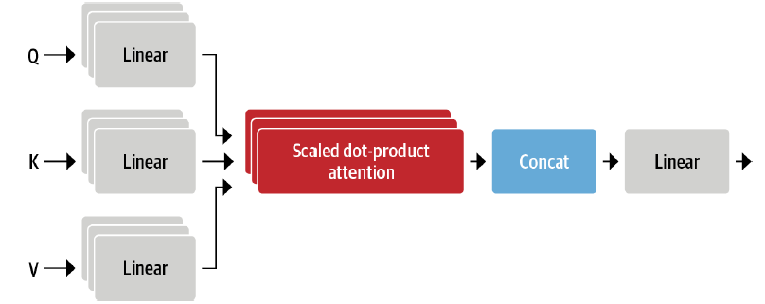
Multi-head Attention
Transformers use multiple sets of linear projections, each forming an attention head.
Why multiple attention heads?
Single-head attention limits the model to focus on just one type of relationship or similarity between tokens.
Multi-head attention allows the model to capture multiple relationships simultaneously, making the representation richer and more nuanced.
For example:
One attention head might capture subject-verb interactions.
Another head could focus on finding related adjectives or descriptive words.
Yet another might identify long-range dependencies within sentences.
These relationships aren't manually defined by humans—instead, the Transformer learns them entirely from data, improving its generalization and interpretative power.

Slide 15
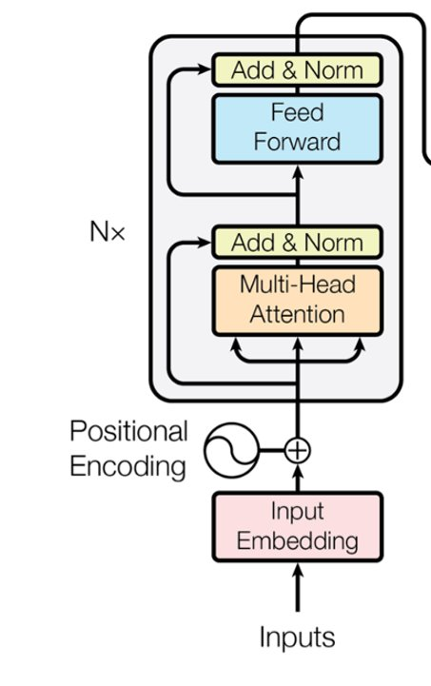
The Encoder Stack
A Transformer encoder typically consists of N=6 identical layers, each following the same structural pattern.
Components of Each Layer:
Each encoder layer has two main sublayers:
Multi-head self-attention: allows tokens to attend to each other.
Position-wise feedforward neural network: applies transformations individually to each token's embedding.
Residual Connections and Layer Normalization:
Residual (skip) connections surround each sublayer:
These connections add the original input (x) to the sublayer's output before applying normalization.
The output after residual connection and normalization is:
LayerNorm(x+Sublayer(x))
Layer Differences Despite Identical Structure:
Although all layers share an identical structure, each encoder layer learns different representations:
Layers differ because they have separate learned parameters (weights).
Each subsequent layer further enriches embeddings by integrating additional context from other tokens.

Slide 16
Building Contextual Representations
Each of the multi-head attention layers (layers 1 through 6) performs the same underlying operations, but each layer learns distinct relationships.
Why don't layers learn identical things?
Each layer progressively enriches token embeddings by adding increasingly nuanced contextual knowledge.
You can think of each layer as searching for different relationships between tokens—similar to how we discover various associations among letters and words when solving a crossword puzzle.
Consistent dimensionality:
Every sublayer (attention and feedforward layers) produces outputs of constant dimension 𝑑 𝑚𝑜𝑑𝑒𝑙
Residual connections and embeddings also maintain this dimension, creating uniformity and stability.
Choosing 𝑑 𝑚𝑜𝑑𝑒𝑙:
In the original Transformer architecture, 𝑑 𝑚𝑜𝑑𝑒𝑙=512, but it can be adjusted based on the task or resources.
The choice of 𝑑 𝑚𝑜𝑑𝑒𝑙is crucial because it significantly impacts model performance and capability.
Scalability:
Transformers can scale by adding more layers, limited only by computational resources. More layers often lead to richer, more powerful representations.

Slide 17
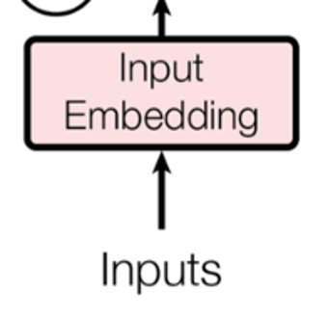
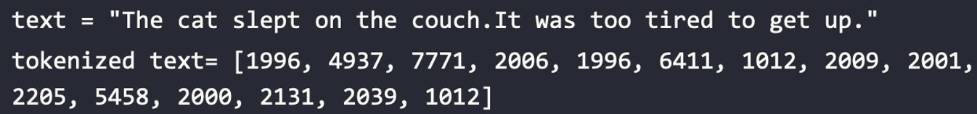
Input Embedding
The input embedding sublayer converts the input tokens to vectors of dimension d_{model} using learned embeddings from another model (transformer/word2vec/one-hot model)
The embedding sublayer works on the tokens that the transformer will find embeddings
Tokenizer could be BPE, word piece, and sentence piece etc.
A tokenizer provides an integer representation that will be used for the embedding process. For example:

Slide 18
Positional Encoding
The self-attention calculation method does not consider position of the tokens
Therefore it does not have any idea of the relative word/token orders
Positional embeddings takes care of this shortcoming
The most basic embedding is simple: augment the token embeddings with a position-dependent pattern of values arranged in a vector
If the pattern is characteristic for each position, the attention heads and feed-forward layers in each stack can learn to incorporate positional information into their transformations
It is possible to learn the pattern, especially when the pretraining dataset is sufficiently large
This works exactly the same way as the token embeddings, but using the position index instead of the token ID as input
Absolute positional representations: Transformer models can use static patterns consisting of modulated sine and cosine signals to encode the positions of the tokens.
This works especially well if the dataset is relatively small.

Slide 19
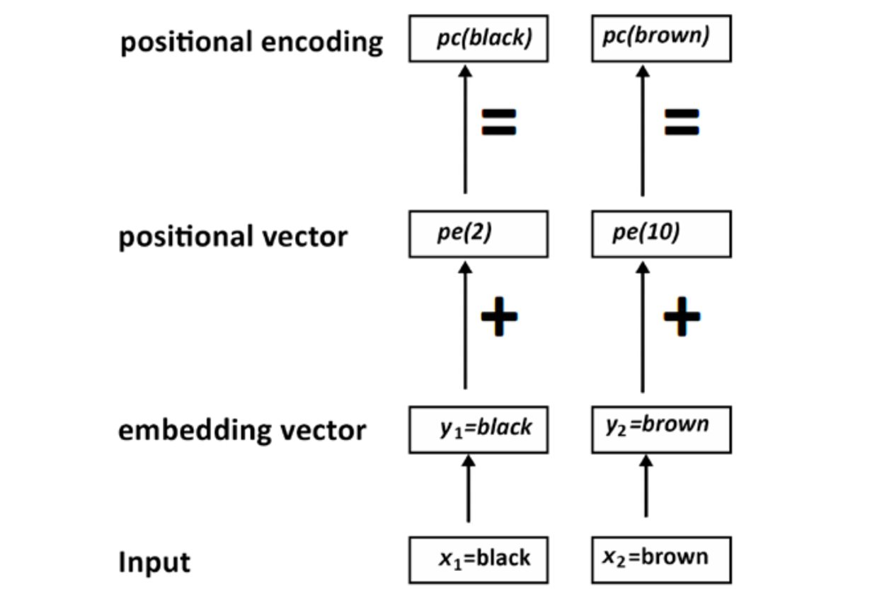
Positional Encoding

Slide 20
Relative Positional Encoding
Although absolute positions are important, the neighboring tokens are most important
Relative positional representations follow this intuition and encode the relative positions between tokens
This cannot be done by just introducing a new relative embedding layer at the beginning since the relative embedding changes for each token depending on where from the sequence we are attending to it
Instead, the attention mechanism itself is modified with additional terms that consider the relative position between tokens
Models such as DeBERTa use such representations

Slide 21
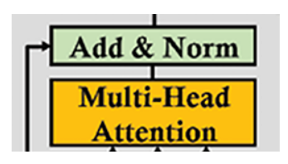
Layer Normalization
All sublayers (attention and feedforward) of the Transformer is followed by Post-Layer Normalization
The Post-LN contains an add function and a layer normalization process
The add function processes the residual connections that come from the input of the sublayer and are normalized
The goal of the residual connections is to make sure critical information is not lost

Slide 22
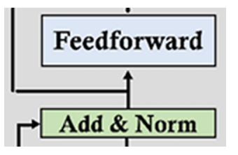
Position-wise Feedforward layer
The FFNs in the encoder and decoder are fully connected
The FFN is a position-wise network
Each position in the input sequence is processed independently but identically
In other words all tokens within a sublayer are transformed using the same set of weights
The term "position-wise" emphasizes that the linear layer operates on a 3D tensor, where the token dimension is the last one.
The FFN is a two stage network with ReLU activation function
The input and output of the FFN layers for original Transformer is dmodel = 512, but the inner layer is larger with dff =2048
The output of the FFN goes to a LN module
Then the normalized output is sent to the next layer of the encoder stack and the multi-head attention layer of the decoder stack

Slide 23
Decoder Layer
The structure of the decoder layer remains the same similar to the encoder for all the N = 6 layers of the original Transformer model
Each layer contains three sublayers:
A multi-headed masked attention mechanism
A multi-headed attention mechanism
A fully connected position-wise feedforward network.
The decoder has a different sublayer (than encoder), which is the masked multi-head attention mechanism
In this sublayer; inputs are partially masked so that the Transformer can predict the next token on its own without looking into the rest of the sequence
Similar to the encoder, residual connection, Sublayer(x), surrounds each of the three main sublayers to ensure proper flow of gradients

Slide 24
Decoder Layer
The output embedding sublayer is only present at the bottom level of the stack, like for the encoder stack
The output of every sublayer of the decoder stack has a constant dimension, d_{model}, like in the encoder stack, including the embedding layer and the output of the residual connections.
We can see that the design is symmetrical: decoder decodes a sequence from the encoded information
The structure of each sublayer and function of the decoder is similar to the encoder

Slide 25
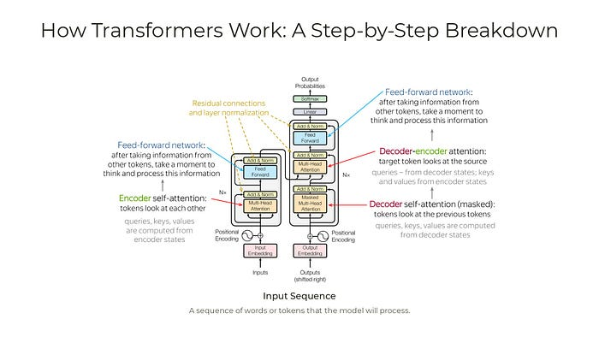
Cross Attention (Co-attention)

Slide 26
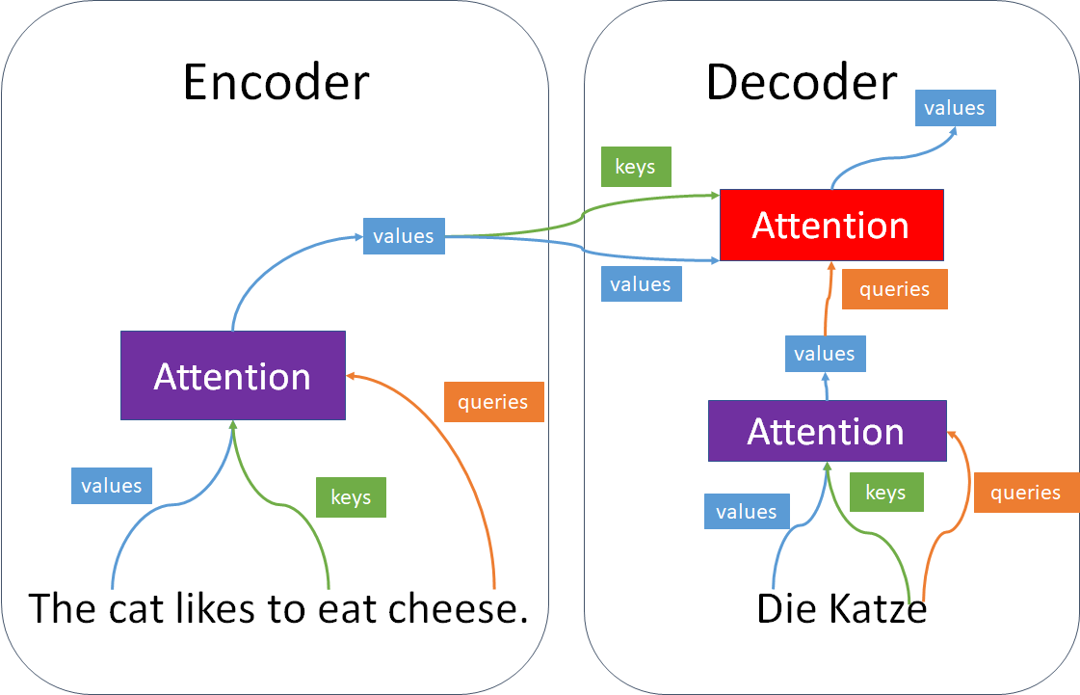
Cross Attention (Co-attention)

Slide 27
Output Embedding
The output embedding layer and position encoding function are the same as in the encoder stack
The output is a translation (or seq-seq transformation) we need to learn
For example for an English to French translation
Input = The black cat sat on the couch and the brown dog slept on the rug
Output = Le chat noir était assis sur le canapé et le chien marron dormait sur le tapis
The output words/tokens go through the word embedding layer and then the positional encoding function, like in the first layer of the encoder stack

Slide 28
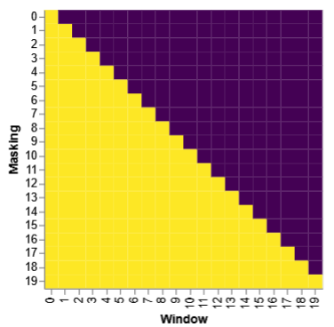
Masked multi-head attention
One of the self-attention sub-layer in the decoder stack is modified to prevent positions from attending to subsequent positions.
This masking, combined with fact that the output embeddings are offset by one position, ensures that the predictions for position i can depend only on the known outputs at positions less than i.

